Slide 1

ONLINE COMPILER USING CLOUD COMPUTING
Computer Science Project I – CS691
Anchal Singh
Ramesh Kyasaram
Tushar Rakholiya
Sanath Gholap
Harshada Chaudhari

Slide 2

INTRODUCTION
In today’s fast and competitive world everything is available on internet, and on web. So, we developed an online compiler using cloud computing. The main objective of this project is to develop a centralized compiler that helps to reduce problems like portability storage, cost, and space.
It is the most convenient tool to compile code, remove errors and debug code. Moreover, we can run the web-based application remotely from any network connection that is independent of platform. The challenge of installing a compiler on each machine is also avoided and therefore, these all benefits make this application suitable of cloud based online compiler make it suitable for performing online exams.

Slide 3

PERSONA
I am John pursuing Master’s from a well-known university. Being a Graduate student in Computer Science, writing and compiling codes in different languages is part of our daily life. Sometimes we find it difficult to get the subscription for different compiler because it’s costly and it will become more costly if we are taking subscription for different compiler for each coding languages.
Therefore, we yearn for a single platform where we can compile at least more frequently used languages (Java, Python, C#, C, C++) at the same platform by making the coder’s life easier.

Slide 4

TECHNOLOGIES USED
Google Cloud Platform
Python(Flask) (Middleware Business Logic)
HTML/CSS (Front-end)
MongoDB (Database)

Slide 5
USER STORIES
ID | Features | As a | I want to | So that
1 | User Registration | User | Enter login details that is the first and last name, e-mail and password. | I can create my profile and register myself on the cloud computing service.
2 | Login | User | Enter registered e-mail and password. | I can authenticate my account and after that I can retrieve previously stored source code.
3 | Compilers for C, C++, C#, Java and Python | User | Select any of the compilers from the drop-down menu. | I can compile the code in any of the programming languages.

Slide 6
ACCEPTANCE CRITERIA
ID | Features | As a | Acceptance Criteria
1 | User Registration | User | 1. Display Website. 2. Display Register or sign in option. 3. A user cannot register without completing all mandatory fields. 4. Information from the form is stored in the registration database. 5. Existing user cannot register again. 6. Commencement and maintaining the session while logged in. 7. Triggers session termination.
2 | Login | User | 1. Login with username/e-mail. 2. Enter password. 3. Forgot username/password.
3 | Compilers for C, C++, C#, Java and Python | User | 1. Display a drop-down menu of the programming languages. 2. Display two text areas for entering the source code and for viewing output/error of the code.

Slide 7
TEST CASES
Test Cases for | Test Case ID | Test Scenario | Test Data | Expected Results | Actual Results | Pass/Fail
Registration | 1 | Check registration form with First name | Sanath | NO Validation Errors | NO Validation Errors | PASS
 | 2 | Check registration form without first name | *Blank* | Validation Errors | Validation Errors | PASS
 | 2 | Check registration form with Last name | Gholap | NO Validation Errors | NO Validation Errors | PASS
 | 4 | Check registration form without Last name | *Blank* | Validation Errors | Validation Errors | PASS
 | 5 | Check registration form with vaild email | sanath2097@gmail.com | NO Validation Errors | NO Validation Errors | PASS
 | 6 | Check registration form without email | *Blank* | Validation Errors | Validation Errors | PASS
 | 7 | Check registration form with Password | testpassword | NO Validation Errors | NO Validation Errors | PASS
 | 8 | Check registration form without Password | *Blank* | Validation Errors | Validation Errors | PASS
 | 9 | Check registration form with invalid email | sanathgholap.com | Validation Errors | Validation Errors | PASS
 | 10 | Check registration form with confirming Password | *Wrong password in confirm field* | NO Validation Errors | NO Validation Errors | PASS
Login | 11 | Check Login page with Password | testpassword | NO Validation Errors | NO Validation Errors | PASS
 | 12 | Check Login page without Password | *Blank* | Validation Errors | Validation Errors | PASS
 | 13 | Registration with pre-registered e-mail ID | sanath2097@gmail.com | User Already Exsists Error | User Already Exsists Error | PASS

Slide 8
PRODUCT BACKLOG
ID | Features | As a | I want to | So that | Priority
1 | User Registration | User | Enter login details that is the first and last name, e-mail and password. | I can create my profile and register myself on the cloud computing service. | High
2 | Login | User | Enter registered e-mail and password. | I can authenticate my account and after that I can retrieve previously stored source code. | High
3 | Compilers for C, C++, C#, Java and Python | User | Select any of the compilers from the drop-down menu. | I can compile the code in any of the programming languages. | Moderate

Slide 9

SPRINTS
Sprint 1
Sprint 2

Slide 10
SPRINT 1
Sprint 1
Sprint 2
Researched about the technologies that can be related to the project
Decided on who will work on which module.

Slide 11
SPRINT BACKLOG
Sprint Task | Module | Priority | Issues Encountered | Start Date | End Date | Status
Sprint 1 : Task 1 | Database | High | We cannot use structured database | 09/04/2020 | 09/18/2020 | Completed
Sprint 1 : Task 2 | Cloud Service | High | Decision of selecting the cloud and storage service depending upon the cost and usage. | 09/07/2020 |  | In-Progress

Slide 12
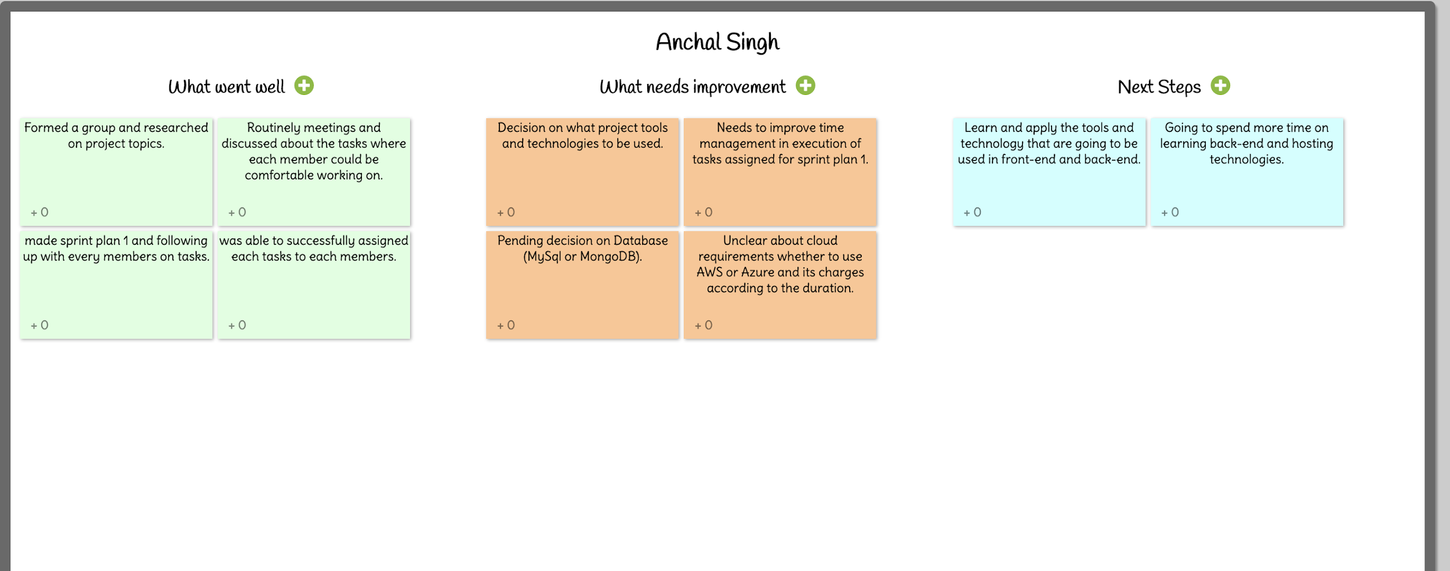
RETROSPECTIVE SPRINT 1

Slide 13
SPRINT 2
Sprint 1
Sprint 2
Selection and learning about web application technology.
Learning about compatibility of database.
Started initial development of web application.

Slide 14
SPRINT BACKLOG
Sprint Task | Module | Priority | Issues Encountered | Start Date | End Date | Status
Sprint 2 : Task 1 | Web Application | Medium | Selecting the layout of the front-end | 09/23/2020 | 10/02/2020 | Completed

Slide 15
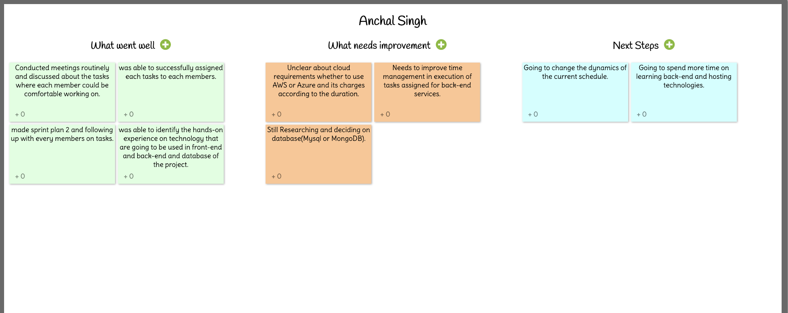
RETROSPECTIVE SPRINT 2

Slide 16
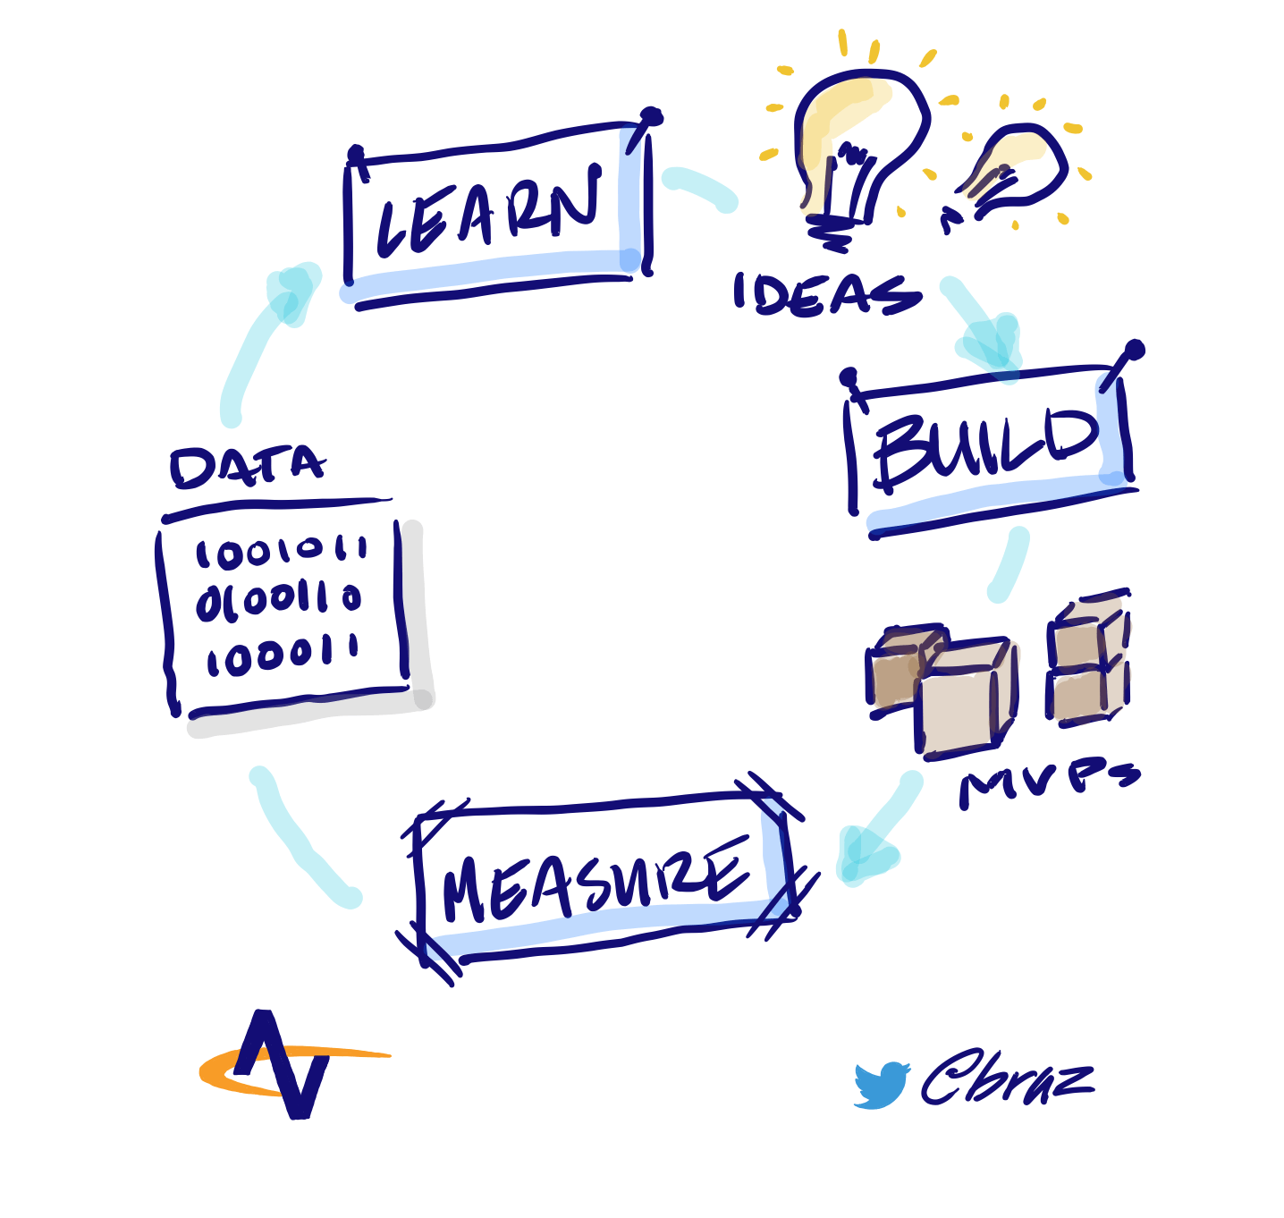
MVP
Which Problem does it solve!
It can be hectic for students or working professionals to download IDEs and virtual machines for individual languages to run their programs in very short amount of time.
Minimum :- An application which can just compile the code.
Viable : An online platform for everyone where anyone can run the code in any of the given programming languages with features like save the source code.
Minimum + Viable :- We are presenting a product which is based on cloud computing with features like login, registration with authentication and compilation of source code.

Slide 17

GITHUB LINK
https://github.com/sg99356n/OnlineCC/wiki/Online-Compiler-Using-Cloud-Computing

Slide 18
THANK YOU

